Slide 1
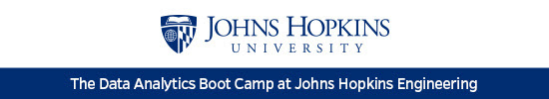
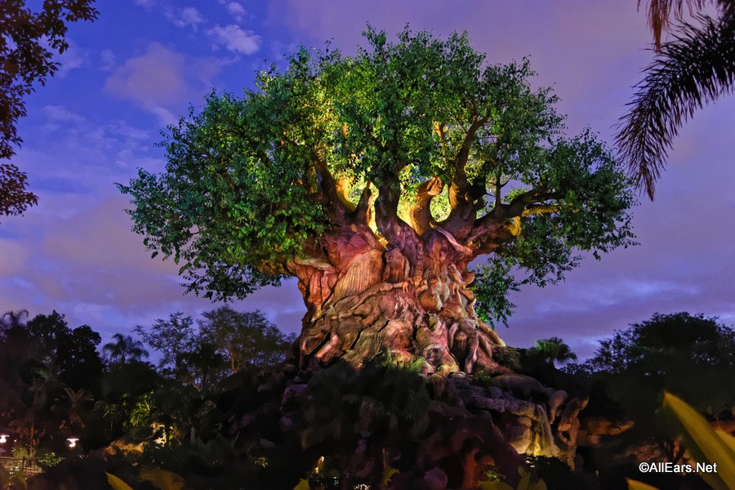
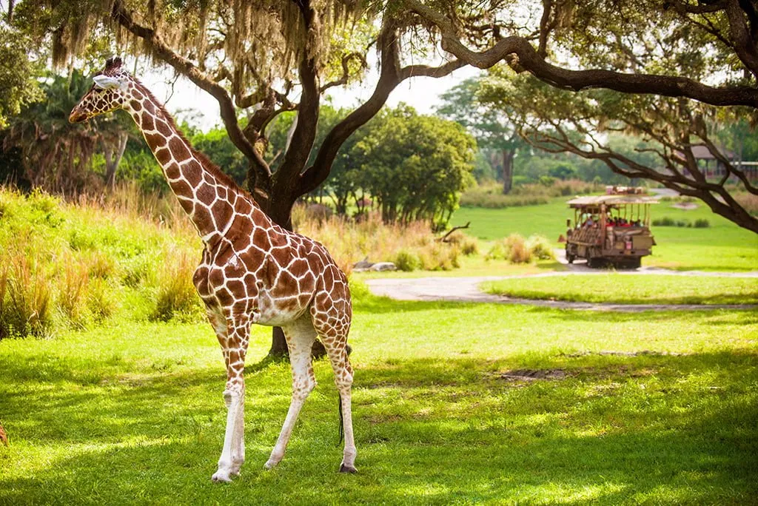
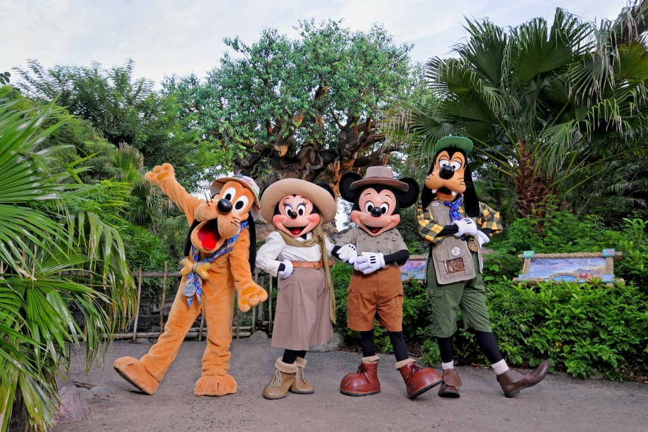

Plan A Family Vacation using Data Analysis
Laura M & Kai H

Slide 2
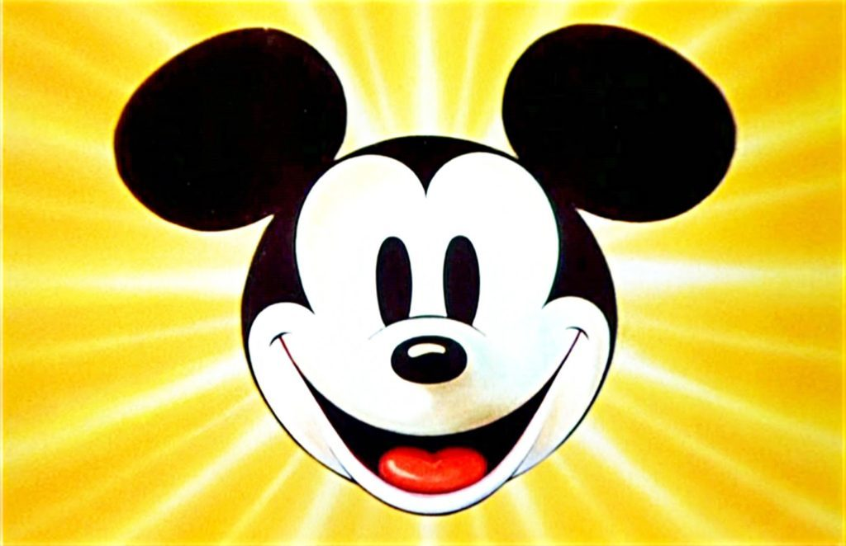

The Dilemma
Missing out on travel
Fun for families
Planning a family vacation
Can we use Machine Learning to
predict the wait time of Disney attractions?
Touring Plans Dataset

Slide 3
ETL Process
Extraction
Metadata- 190 variables each day 2015-2019, csv
Attraction wait times for most days 2015-2019, csv
Decided on 5 attractions in Animal Kingdom Park
Cleaning- Python Pandas and pgAdmin4
Dropped 2 attractions- didn’t span entire date range
Metadata had multiple entries for a date range
Average wait time for each day
Decided on 5 variables for ML model

Slide 4
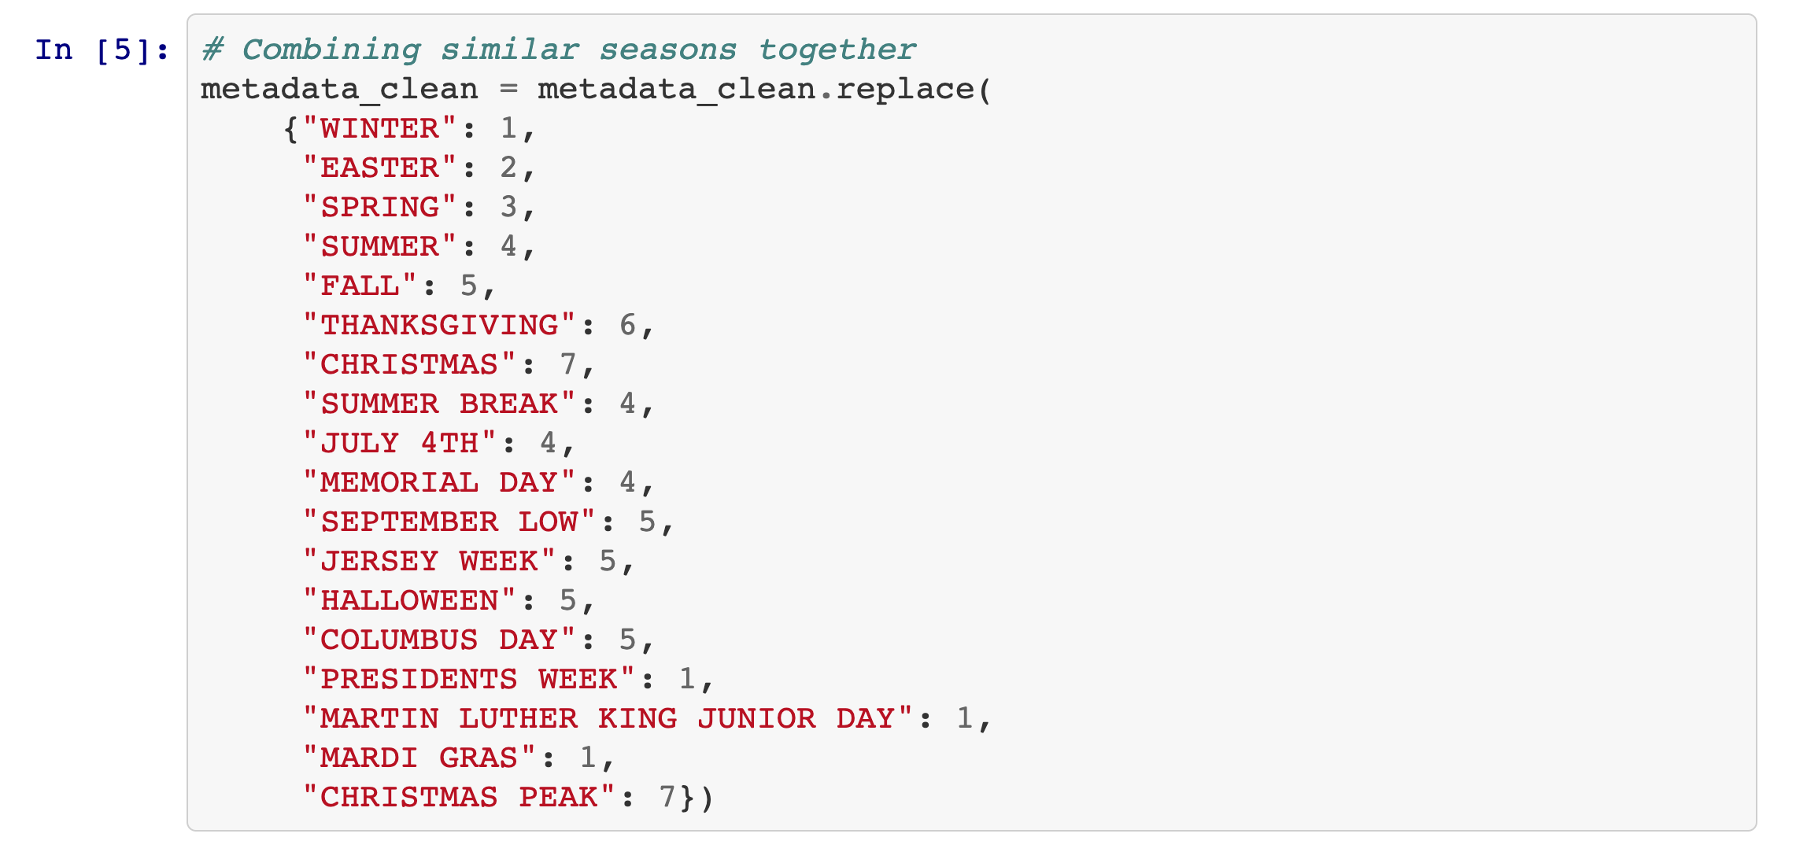
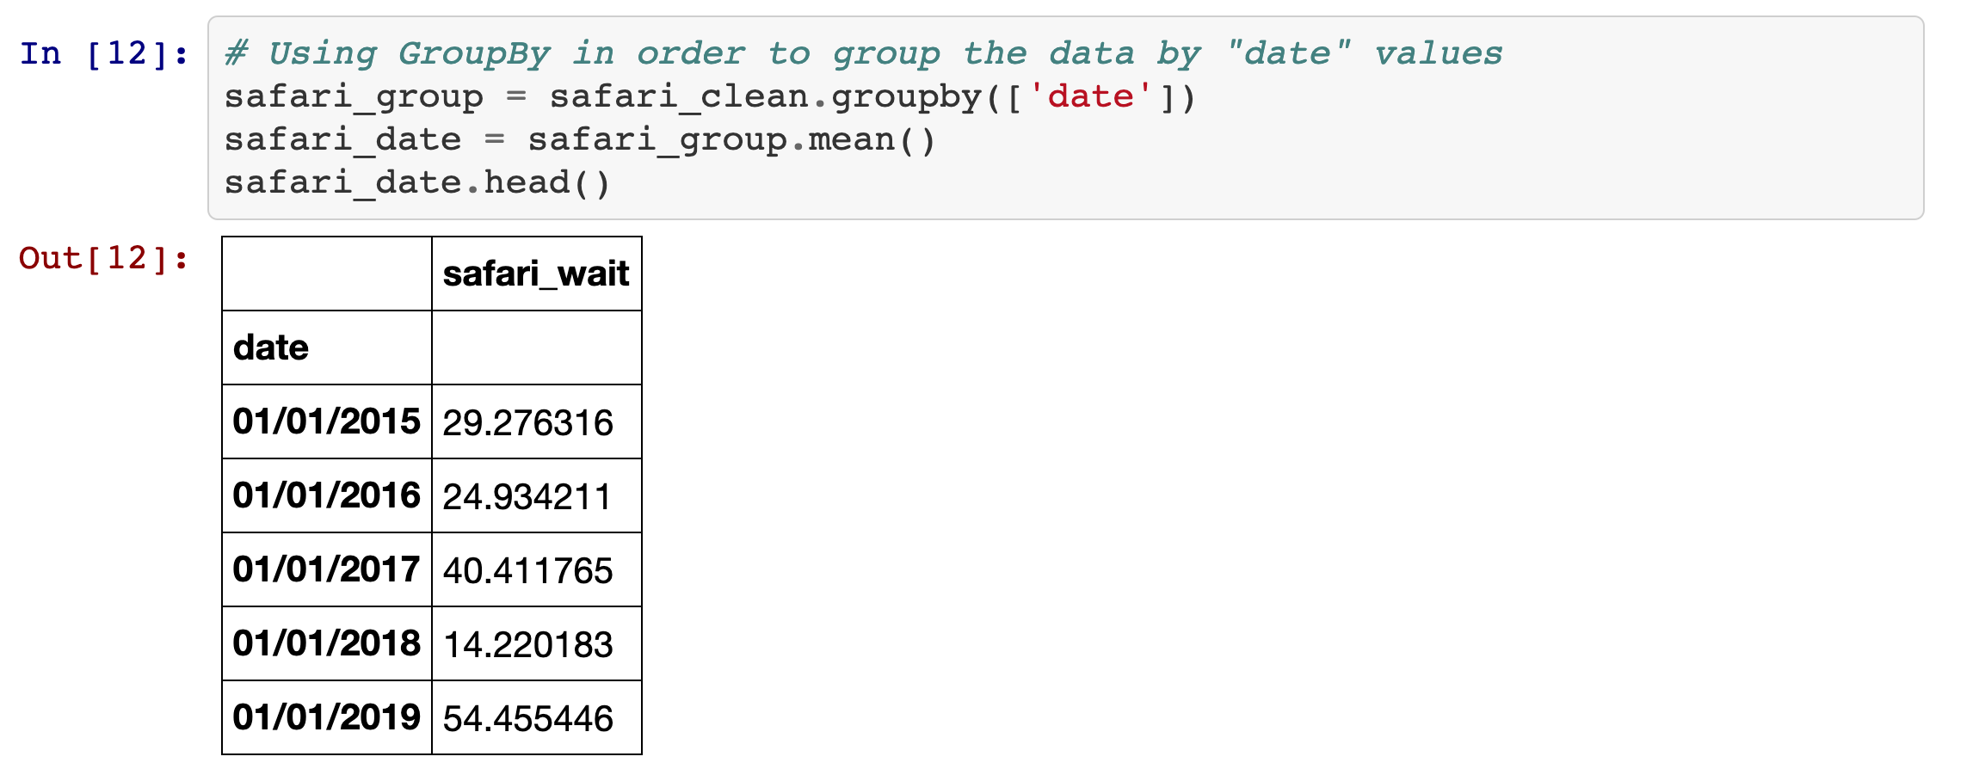
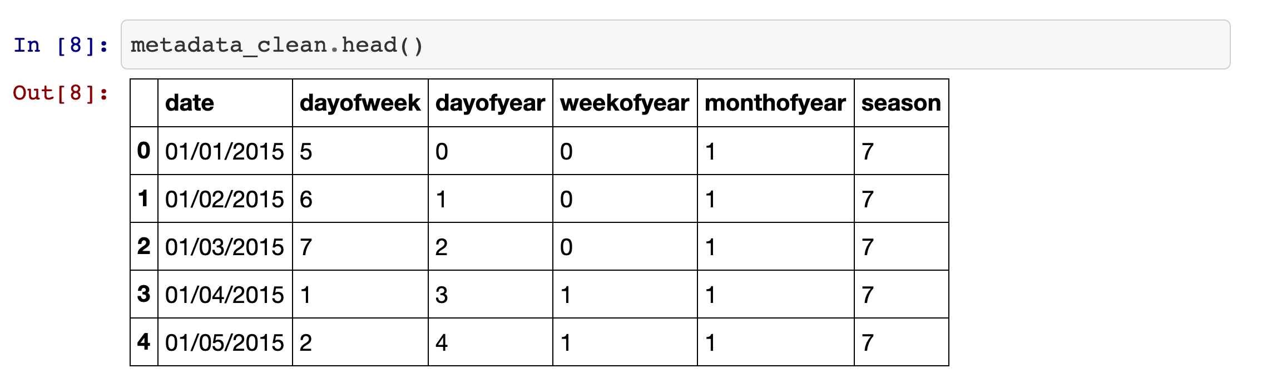
Machine Learning Prep
Converted variable values to integers
Random Forest

Slide 5
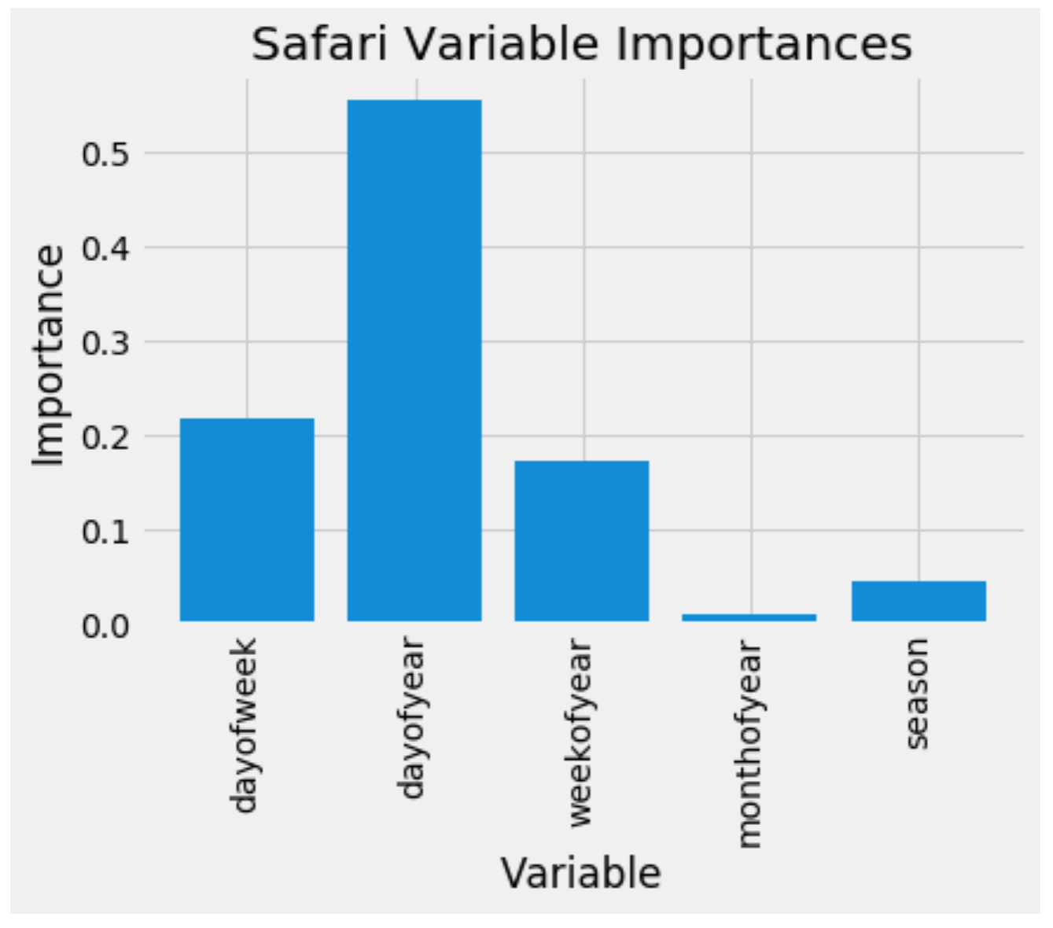
Machine Learning Process
Kilimanjaro Safari
Accuracy: 59.47%
Mean Absolute Error: 12.91 minutes

Slide 6
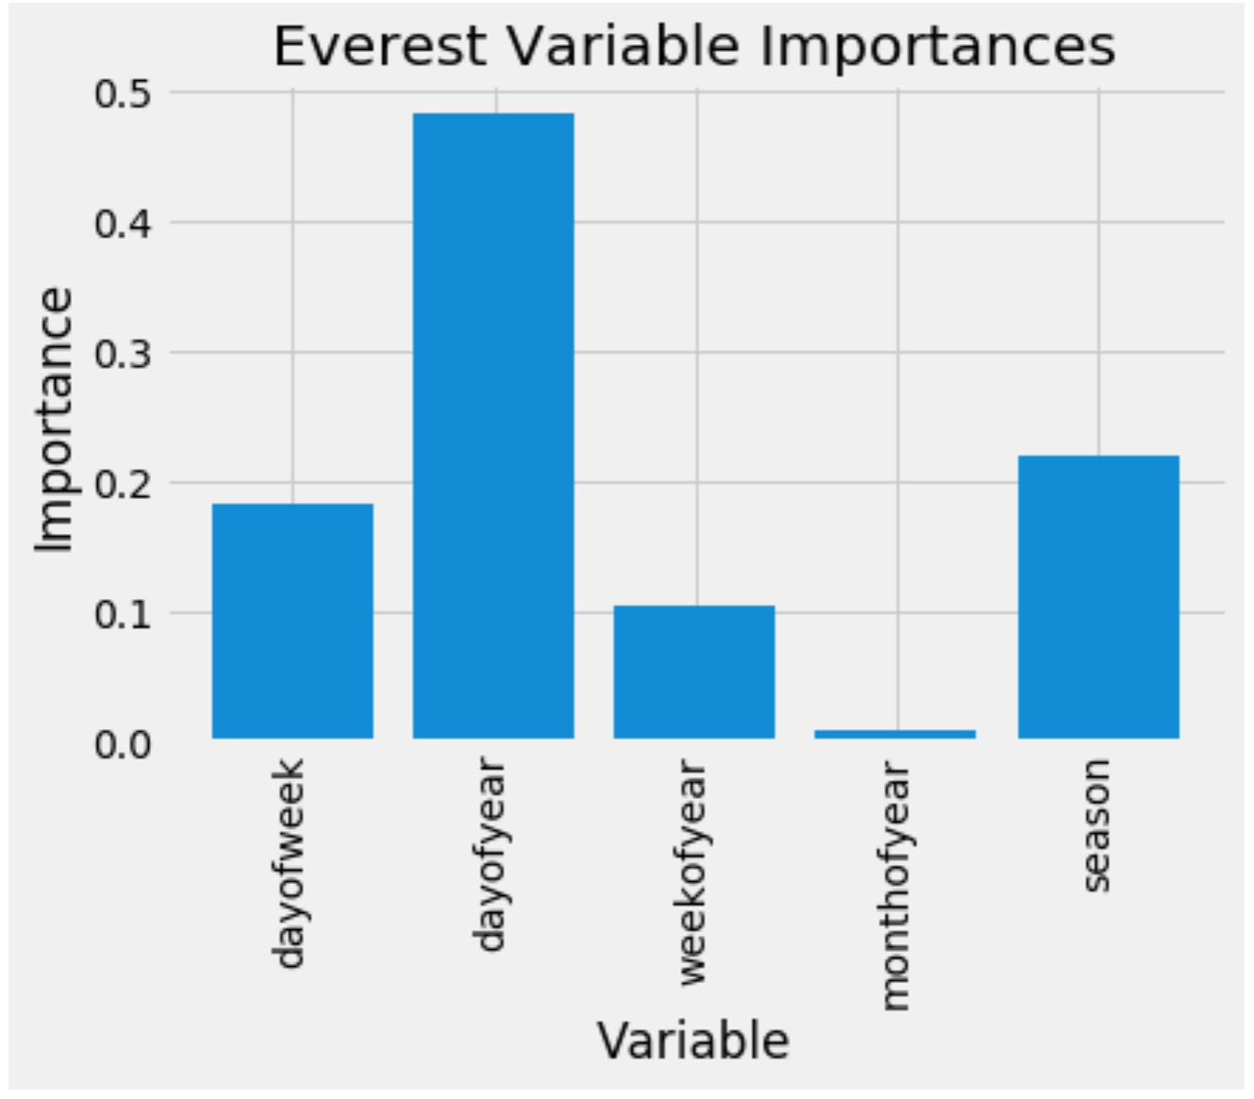
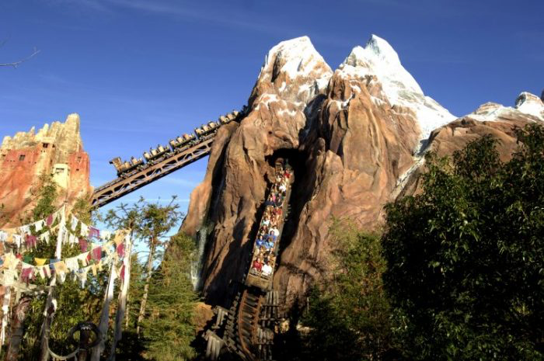
Machine Learning Process
Expedition Everest
Accuracy: 70.68%
Mean Absolute Error: 8.3 minutes

Slide 7
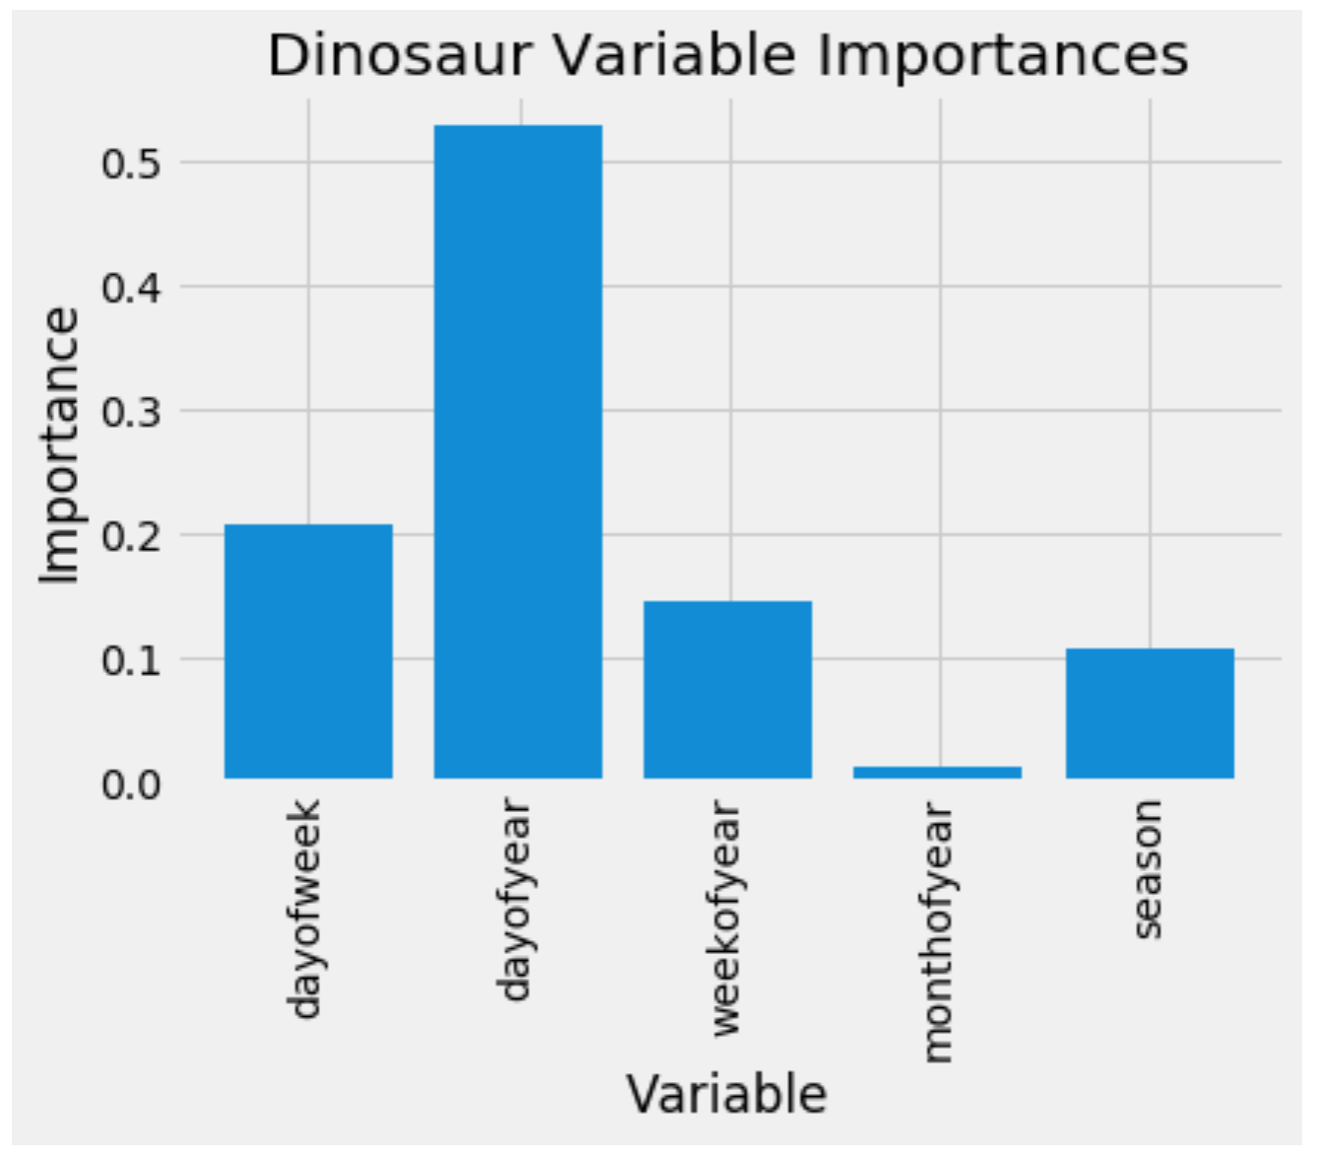
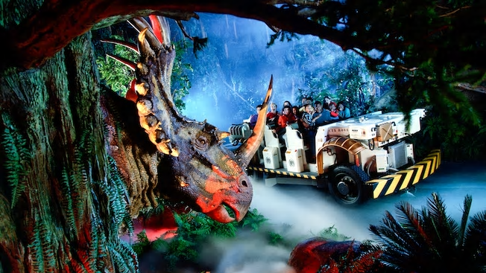
Machine Learning Process
DINOSAUR
Accuracy: 71.63%
Mean Absolute Error: 6.8 minutes

Slide 8
Machine Learning Process
ML Predictions
Created csv and converted to json
Created html file to display table with javascript code to select specific date and display values on button-click
Created GitHub pages site
https://lmm9.github.io/FinalProject_Disney/

Slide 9
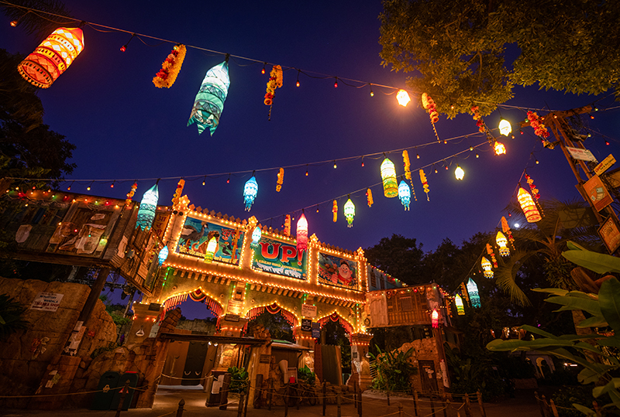
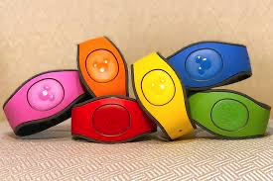
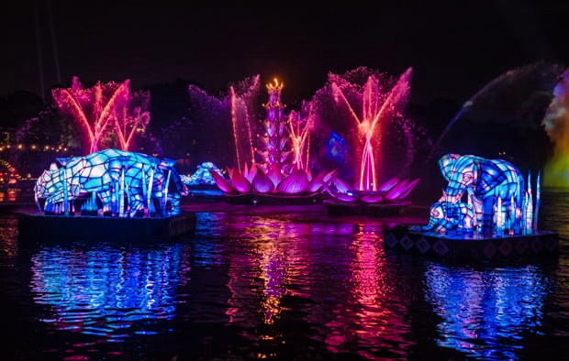
Project Wrap Up
Next Steps
Include more attractions and parks
Create ML models to predict based on the hour or minute

Slide 10
Credits
Datasets
Disney World Metadata and Ride Wait Time Datasets, TouringPlans.com, January 2015 - December 2019, https://www.touringplans.com/walt-disney-world/crowd-calendar/#DataSets, Accessed 22 December 2020.
Photos
Allears.net, disneytouristblog.com, tipstripflorida.com, touringplans.com, tripswithtykes.com,

Slide 11

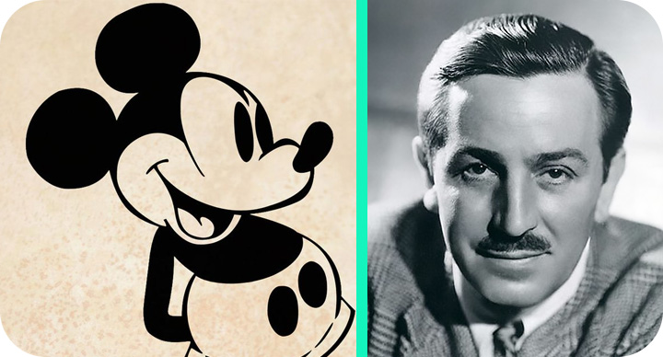
How ML can improve a family’s life Post-Covid?

Slide 12

https://www.slidescarnival.com/
Questions/ Comments Welcomed
Free templates for all your presentation needs
For PowerPoint and Google Slides
100% free for personal or commercial use
Ready to use, professional and customizable
Blow your audience away with attractive visuals

